Slide 1

First-trimester treatment with artemisinin derivatives versus non-artemisinin antimalarials and the risk of adverse pregnancy outcomes in Africa and Asia: Updated individual patient data meta-analysis
Saito M., McGready R., Tinto H., Rouamba T., Mosha D., Rulisa S., Kariuki S., Desai M., Manyando C., Njunju E.M., Sevene E. , Vala A., Augusto O., Clerk C., Were E., Mrema S., Kisinza W., Byamugisha J., Kagawa M., Singlovic J., Yore M., van Eijk A., Mehta U., Stergachis A., Hill J., Stepniewska K., Gomes M., Guerin P., Nosten F., ter Kuile F.O., Dellicour S.
RBM Webinar, 15 February 2023

Slide 2


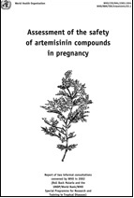
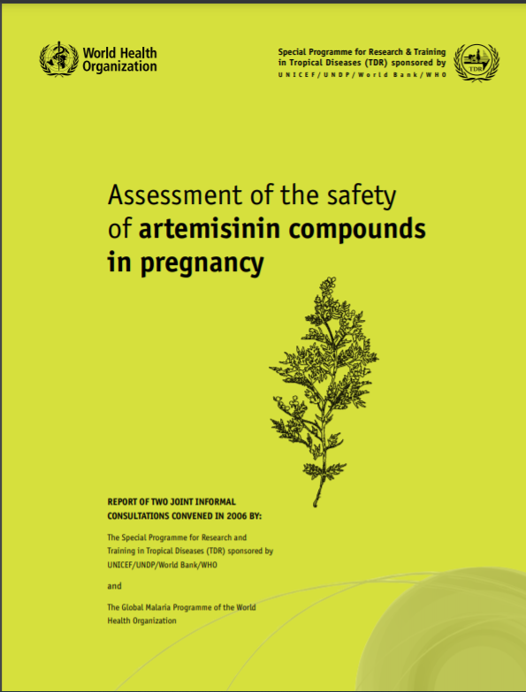
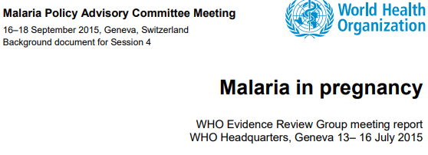
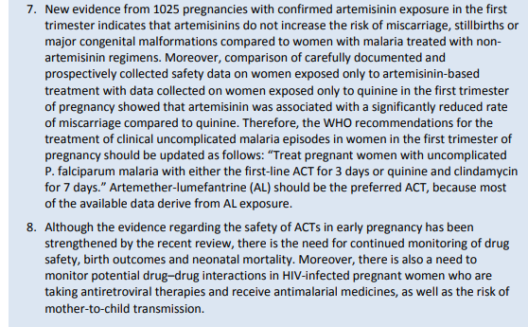
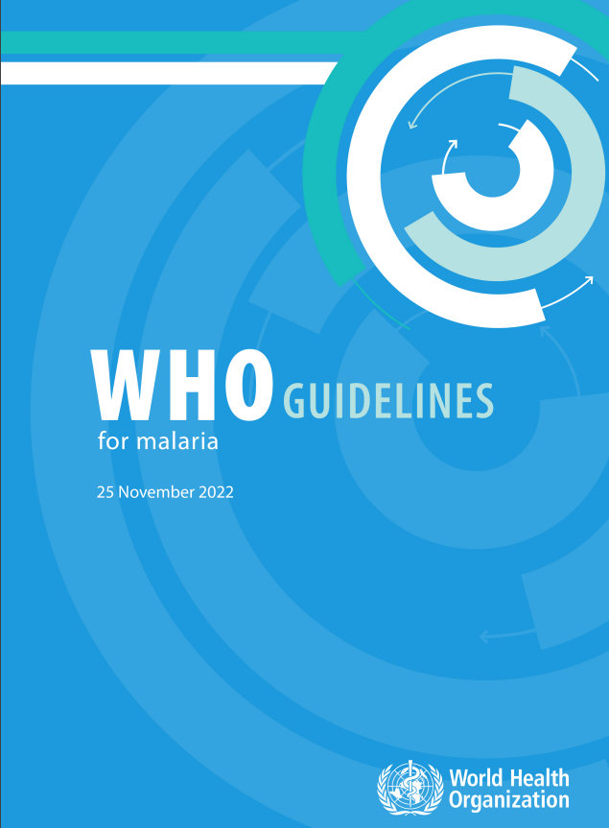
WHO Review of evidence on artemisinin safety in pregnancy
WHO reviews:
  2 informal consultations 2002 and 2006
    > insufficient evidence to change policy recommendations.
  Evidence Review Group and Malaria Policy Advisory Committee Meetings in 2015
  > recommended update to include ACT as an option in 1st trimester but not adopted by WHO.
  Guideline Development Group in 2022
  > recommended update to include AL as preferred option in 1st trimester implemented in Nov 2022.

Slide 3
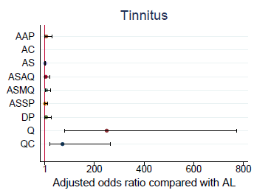
Research in context
ACTs | Quinine + Clindamycin
Shorter treatment course (3 vs 7 days for quinine) Better tolerated Longer post-treatment prophylaxis Better gametocidal property -> reduce onwards transmission Better efficacy (demonstrated in 2nd/3rd trimester & non-pregnant populations) | Lengthy and complex treatment regimen (8-hourly for 7 days) Not well tolerated Poor adherence and treatment failure Quinine monotherapy mostly used Only used for 1st trimester population
      2nd/3rd trimester, PCR corrected treatment failure risk
      for quinine vs AL : adjusted HR 6.11 (95%CI: 2.57–14.54)
From Saito et al 2020 Lancet Inf Dis, 20(8)

Slide 4
Study aim
To compare the risk of adverse pregnancy outcomes between artemisinin-based (ABT) and non-artemisinin treatment (non-ABT) of malaria in the 1st trimester and the suggested artemisinin embryo-sensitive period

Slide 5
Study Design and Methods
Updated systematic review and individual patient data (IPD) meta-analysis
Study inclusion
  Confirmed artemisinin exposures in 1st trimester
  Prospective follow-up
  Internal comparison group
Antimalarial exposures:
  1st trimester: 2-13 weeks (inclusive) post-LMP
  Artemisinin embryo-sensitive period: 6-12 weeks (inclusive) post-LMP
  Exposures confirmed by >=2 data sources and/or medical record
Outcome:
  Primary: composite endpoint including miscarriage, stillbirth and major congenital anomalies

Slide 6
Statistical analysis
Primary analysis: ABT vs non-ABT
Subgroup analysis: specific ACT vs quinine
IPD: 1-stage random-effects adjusting for clustering by study site
Cox regression with shared frailty
  Gestational week as the time scale
  Left truncated
  Right censoring
  Exposure time-dependant
Sensitivity analyses
  E-values to assess potential unmeasured confounding
  Using unexposed comparison group
  Assessing smaller exposure risk-windows
  Inclusion of unconfirmed exposures
  Different statistical models
  Multiple imputations of missing data

Slide 7
Results

Slide 8
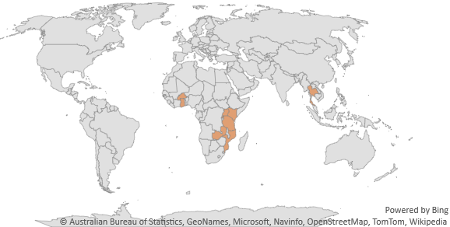
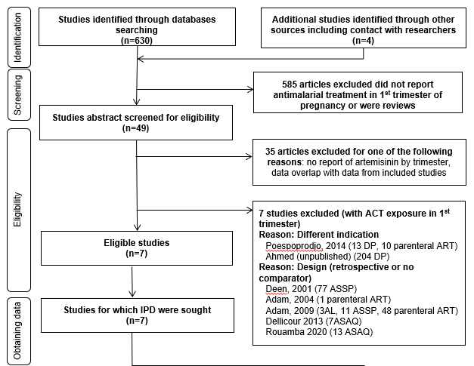
Result- Literature Search
7 included studies (12 cohorts) with 1st trimester artemisinin data
6 studies from Africa and 1 from Asia
34,178 pregnancies
  1,813 (5%) confirmed antimalarial in 1st trimester
  737 (2%) ABT: 74% Africa & 71% AL
  1,076 (3%) non-ABT: 25% Africa & 85% Quinine
Addition to 2017 review:
8,126 pregnancies
60 ABT 1st trimester exposures
309 non-ABT 1st trimester exposures

Slide 9
Result- Artemisinin vs non-Artemisinin

Slide 10
Result- Artemether-Lumefantrine vs Quinine

Slide 11
Result- Congenital anomalies
Congenital anomaly subgroup | First trimester |  |  | Embryo-sensitive period
 | ABT (n=623) | Non ABT (n=681) | Unexposed (n=26270) | ABT (n=503) | Non ABT (n=558)
Any major congenital anomaly | 2* (0.32%) | 8 (1.17%) | 182 (0.69%) | 2** (0.40%) | 8 (1.43%)
Cases with multiple congenital anomalies | 0 (0%) | 1 (0.15%) | 36 (0.14%) | 0 (0%) | 1 (0.18%)
Nervous system | 0 (0%) | 0 (0%) | 27 (0.10%) | 0 (0%) | 0 (0%)
Eye | 0 (0%) | 0 (0%) | 8 (0.03%) | 0 (0%) | 0 (0%)
Ear, face and neck | 0 (0%) | 0 (0%) | 13 (0.05%) | 0 (0%) | 0 (0%)
Congenital heart defects | 0 (0%) | 1 (0.15%) | 15 (0.07%) | 0 (0%) | 1 (0.18%)
Oro-facial clefts | 1 (0.16%) | 2 (0.29%) | 30 (0.12%) | 0 (0%) | 2 (0.36%)
Digestive system | 0 (0%) | 0 (0%) | 20 (0.08%) | 1 (0.20%) | 0 (0%)
Abdominal wall defects | 0 (0%) | 0 (0%) | 10 (0.04%) | 0 (0%) | 0 (0%)
Urinary | 0 (0%) | 0 (0%) | 4 (0.02%) | 0 (0%) | 0 (0%)
Genital | 0 (0%) | 0 (0%) | 8 (0.03%) | 0 (0%) | 0 (0%)
Limb | 1 (0.16%) | 5 (0.73%) | 46 (0.18%) | 1 (0.20%) | 5 (0.90%)
Other anomalies / syndromes | 0 (0%) | 1 (0.15%) | 24 (0.10%) | 0 (0%) | 1 (0.18%)
Cases with anomalies excluded from EUROCAT subgroups | 0 (0%) | 0 (0%) | 3 (0.01%) | 0 (0%) | 0 (0%)
*1 case of cleft lip and palate and 1 case of bilateral syndactyly.
** 1 case of bilateral syndactyly and 1 case imperforated anus.
Studies were not designed to systematically screen and detect congenital heart defects.

Slide 12
Conclusions
No difference in risk of stillbirth, miscarriage or major congenital anomalies in confirmed ABT exposure vs non-ABT antimalarials considered safe in the 1st trimester
  excludes a 1.03-fold and 1.45-fold increase in adverse pregnancy outcomes with ABT vs non-ABT in the 1st trimester and embryo-sensitive period
1st trimester AL Rx associated with a 42% lower risk of adverse pregnancy outcomes compared to quinine (aHR: 0.58, 95%CI 0.36- 0.92)
The benefit-risk favours the use of AL over quinine for confirmed malaria in the 1st trimester of pregnancy based on the evidence for safety, efficacy, tolerability, and adherence
Targeted surveillance needed to be able to detect signals for specific congenital anomalies

Slide 13
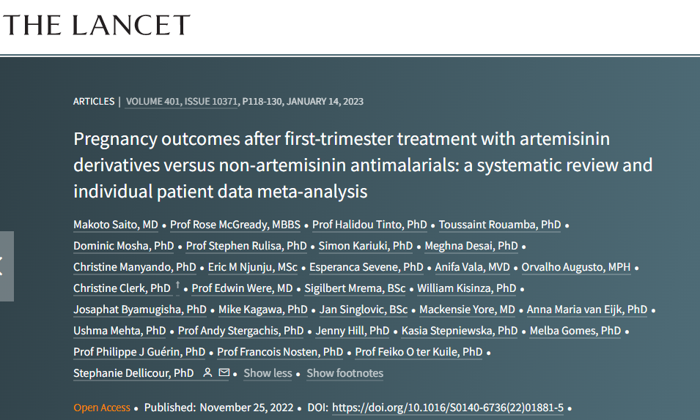
Acknowledgements
All study participants and study teams
IPD contributors and co-authors
Birth Defect Panel set up for the WHO Pregnancy Registry pilot studies
WWARN
Funders of meta-analysis: Medicines for Malaria Venture (MMV) and the World Health Organization (WHO)

Slide 14
Thank you

